Slide 2
LabVIEW Web Services Getting Started: Reading Query Fields Custom output streams

Slide 3
Changes to Web Methods
As we move in to more complex examples, we need to be aware of some key concepts:
Explicit and Implicit URL Mapping.
Public and Private Folders, and when to use them.
How to get started with HTML and Javascript.
How to add publicly-available web resources to our code.

Slide 4
Implicit URL Mapping
In the examples on ni.com, to get user input from the web in to LabVIEW we create a control, connect it to a terminal, and the web service maps the control to the URL.
This method works, but is inflexible. We will be using explicit URL queries for these examples.

Slide 5
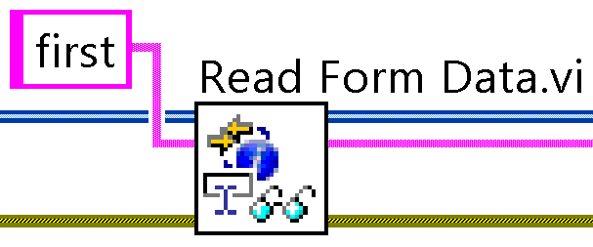
Reading form data
To pass data from our browser interface to our web service, we will use the Read Form Data.vi.
This example gets the value of the “first” argument in the URL. http://127.0.0.1:8001/WebClient/AddTwo?first=10&second=20"

Slide 6
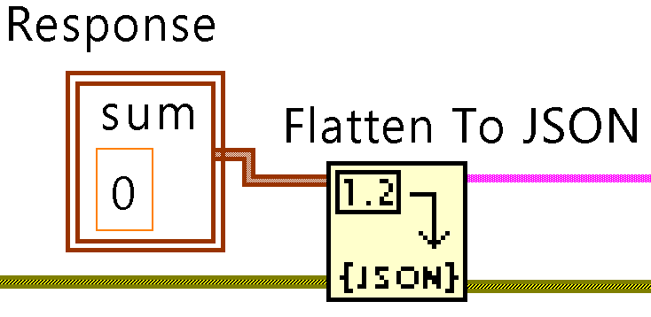
Writing Response Data
By default, LabVIEW web services uses XML to write data back to the web client. Because we will be developing primarily in JavaScript, we will write back a JSON array instead.
This allows us to easily parse the data returned from LabVIEW using JavaScript and Jquery.

Slide 7
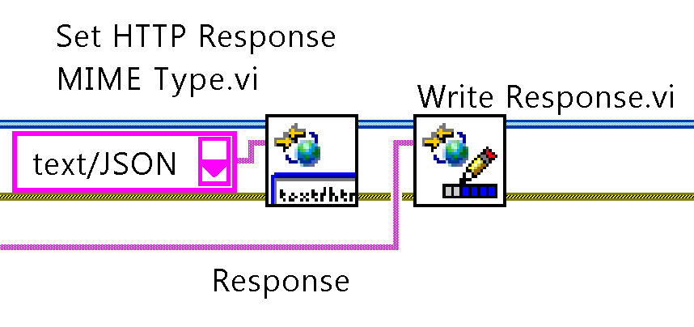
Writing Response Data (cont’d)
We then write the MIME Type and the JSON response string back to our browser.

Slide 8
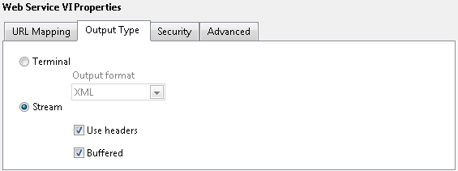
Changing the output type
Finally, we need to tell the web service that we want to use the settings specified in our VI rather than letting LabVIEW auto-map the controls and indicators.

Slide 9
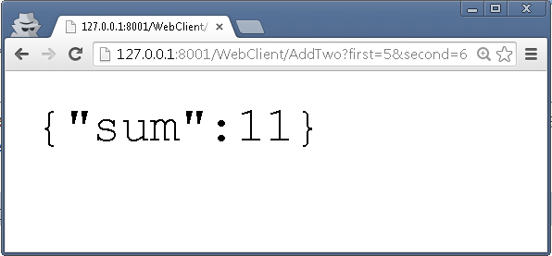
Example
The AddTwo.vi in the AddTwoWithSubmitButton.lvproj example can be executed from a browser using the URL shown in the address bar.

